Slide 1
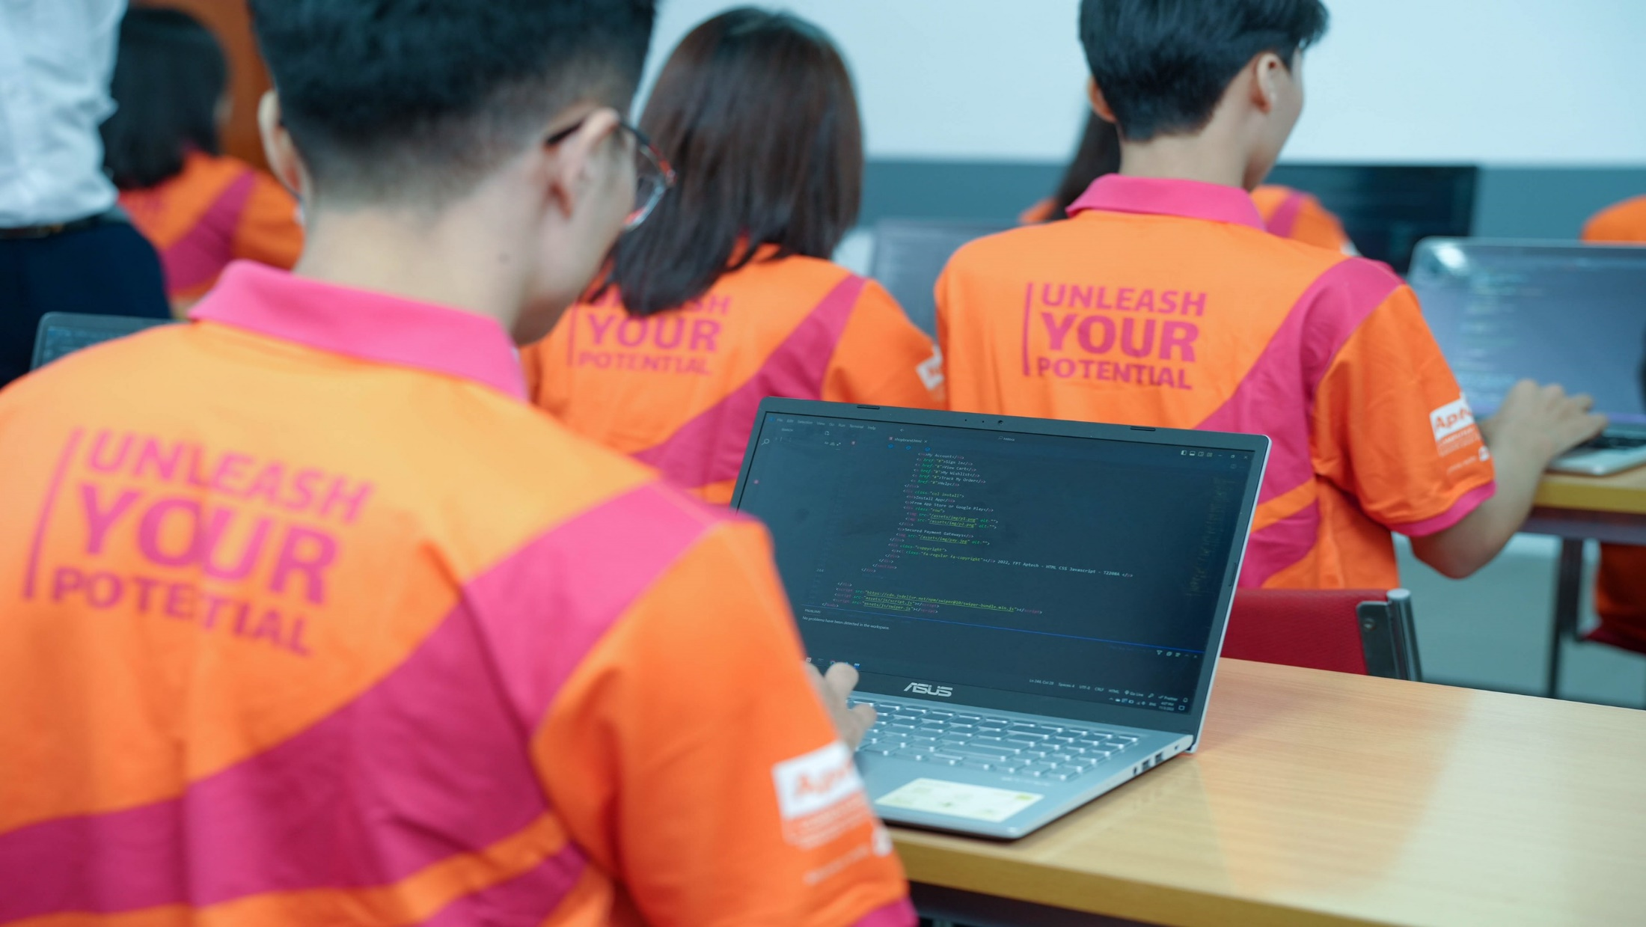


T2307A-FPT Aptech Hanoi
Group 2
Website:
News and Reporting

Slide 2
01
03
Đặng Hồng Quân
Tô Xuân Bách
02
04
Đỗ Thị Diệp Quyên
Nguyễn Anh Ngọc
Team Member

Slide 3
Introduction
The thirst for learning, upgrading technical skills and applying the concepts in real life environment at a fast pace is what the industry demands from IT professionals today. However busy work schedules, far-flung locations, unavailability of convenient time-slots pose as major barriers when it comes to applying the concepts into realism. And hence the need to look out for alternative means of implementation in the form of laddered approach.
The above truly pose as constraints especially for our students too! With their busy schedules, it is indeed difficult for our students to keep up with the genuine and constant need for integrated application which can be seen live especially so in the field of IT education where technology can change on the spur of a moment. Well, technology does come to our rescue at such times!!
Keeping the above in mind and in tune with our constant endeavour to use Technology in our training model, we at Aptech have thought of revolutionizing the way our students learn and implement the concepts using tools themselves by providing a live and synchronous eProject learning environment!

Slide 4
TECHNOLOGY
React JS
1
HTML CSS
3
2
Bootstrap
JavaScript
4

Slide 5
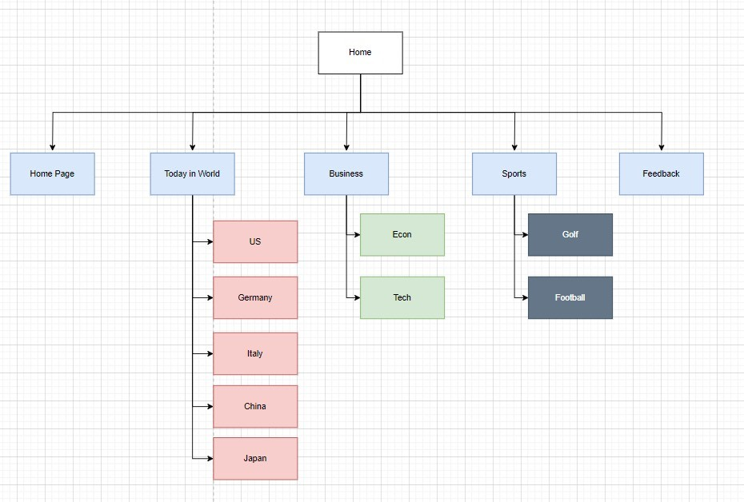
Site Map

Slide 6
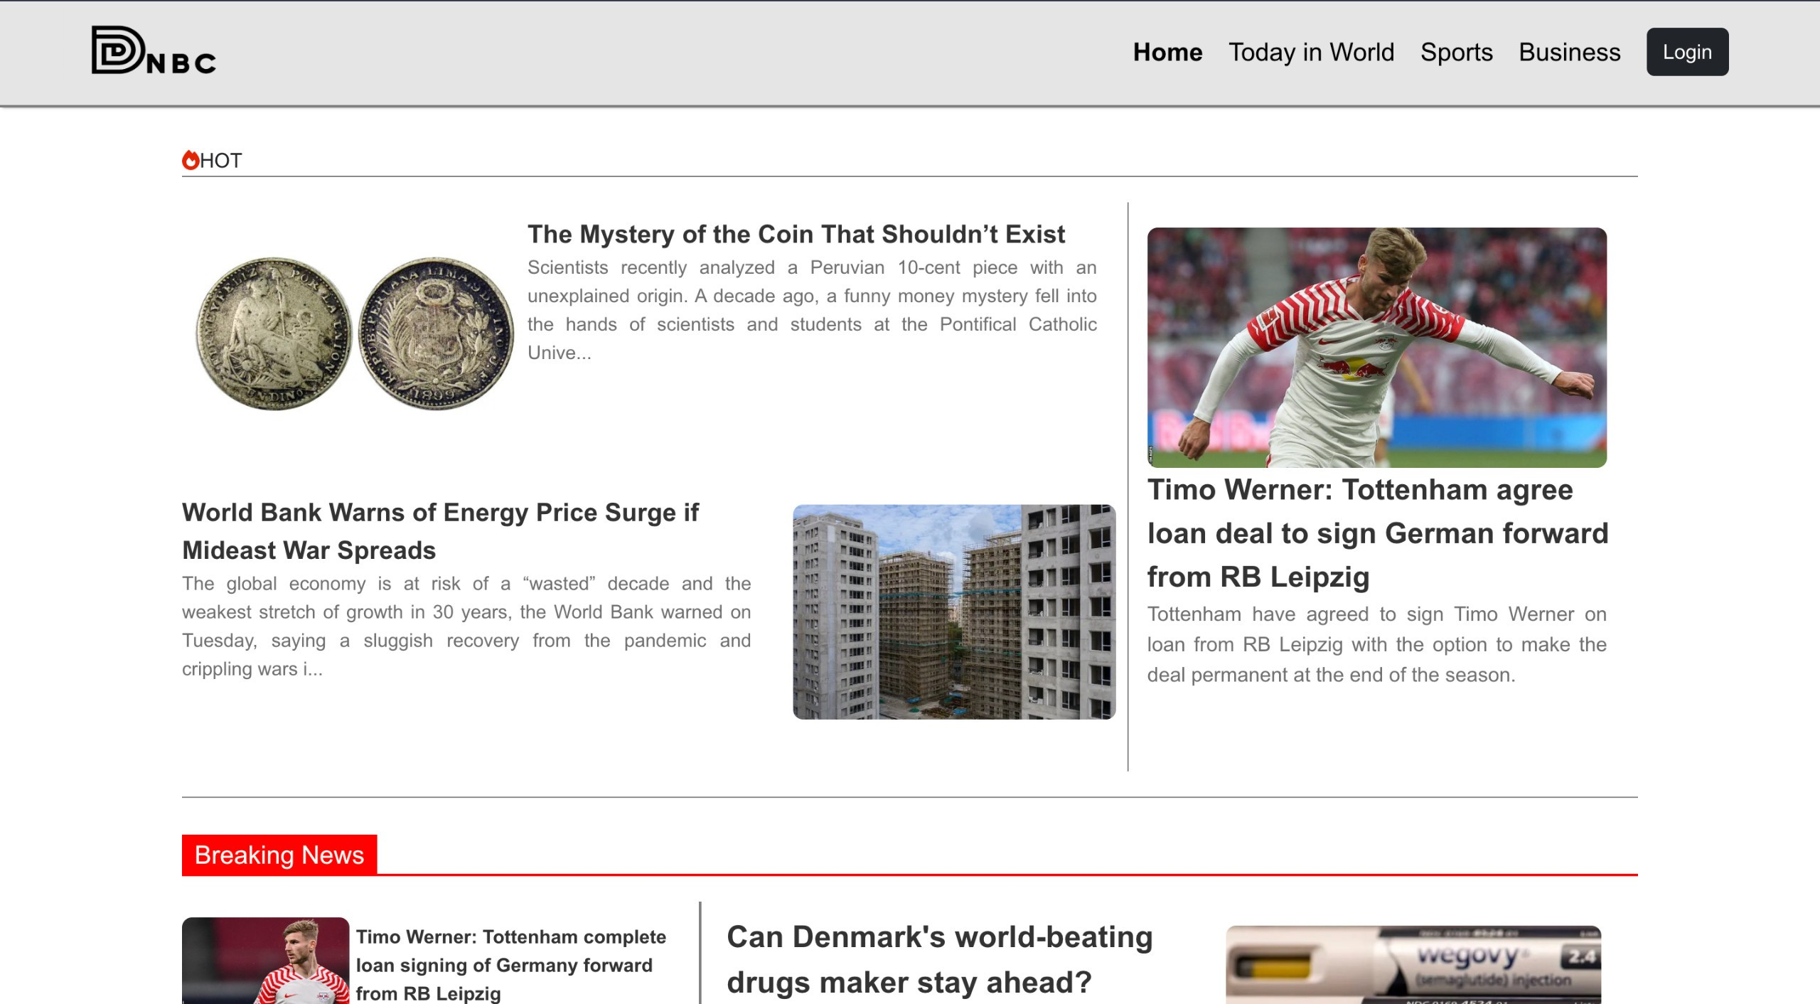
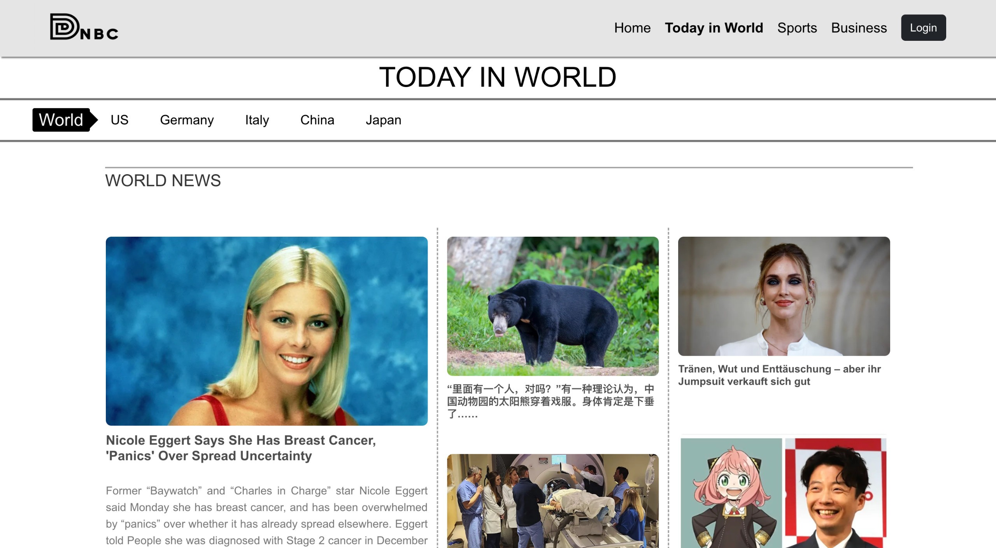
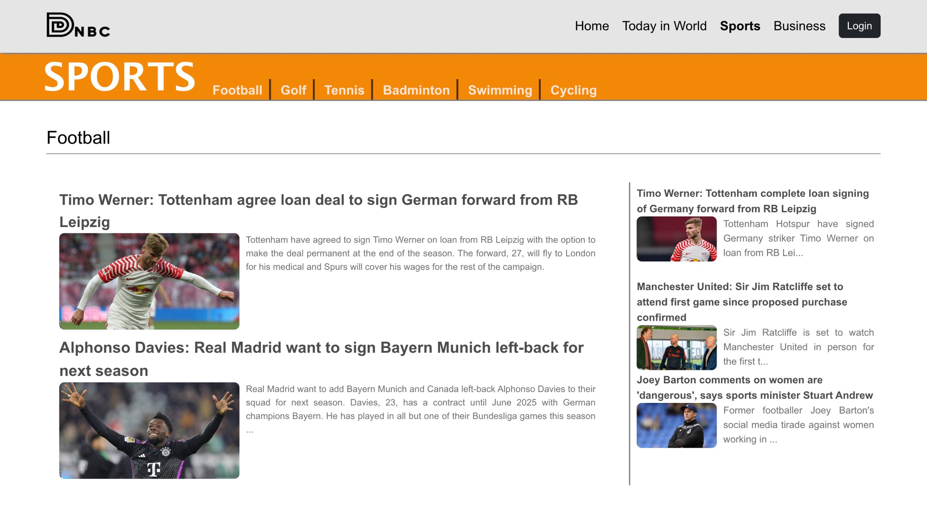
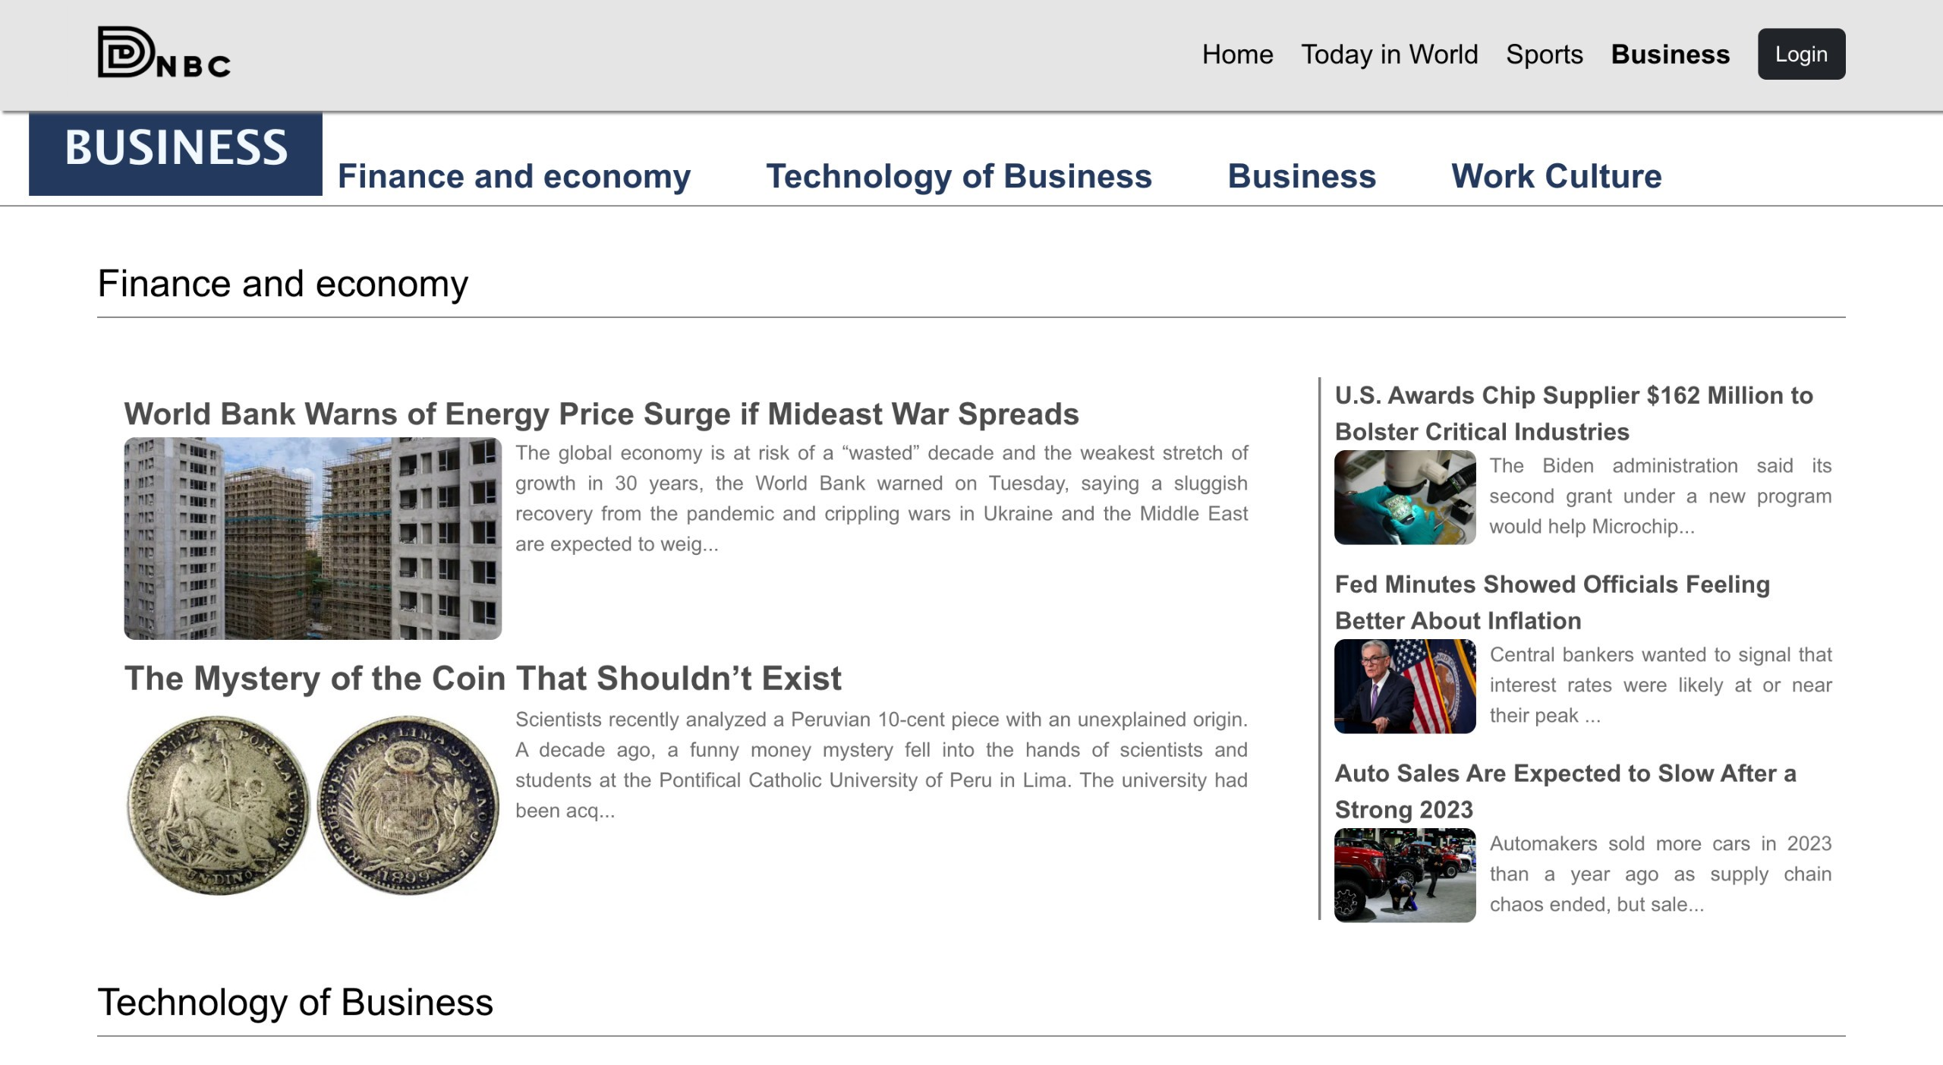
MAIN SCREENS

Slide 7
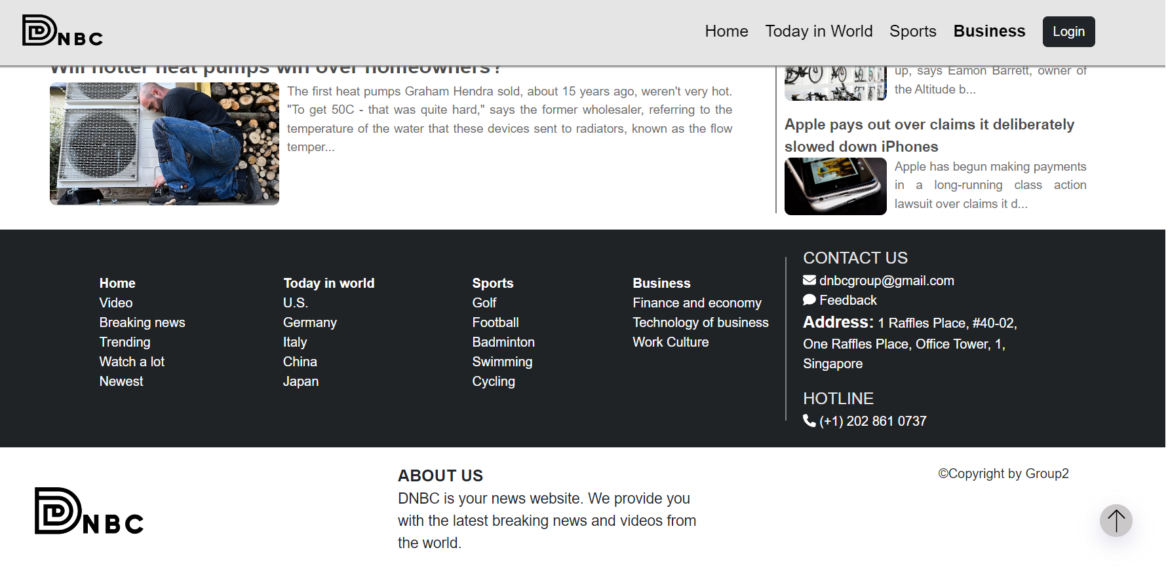
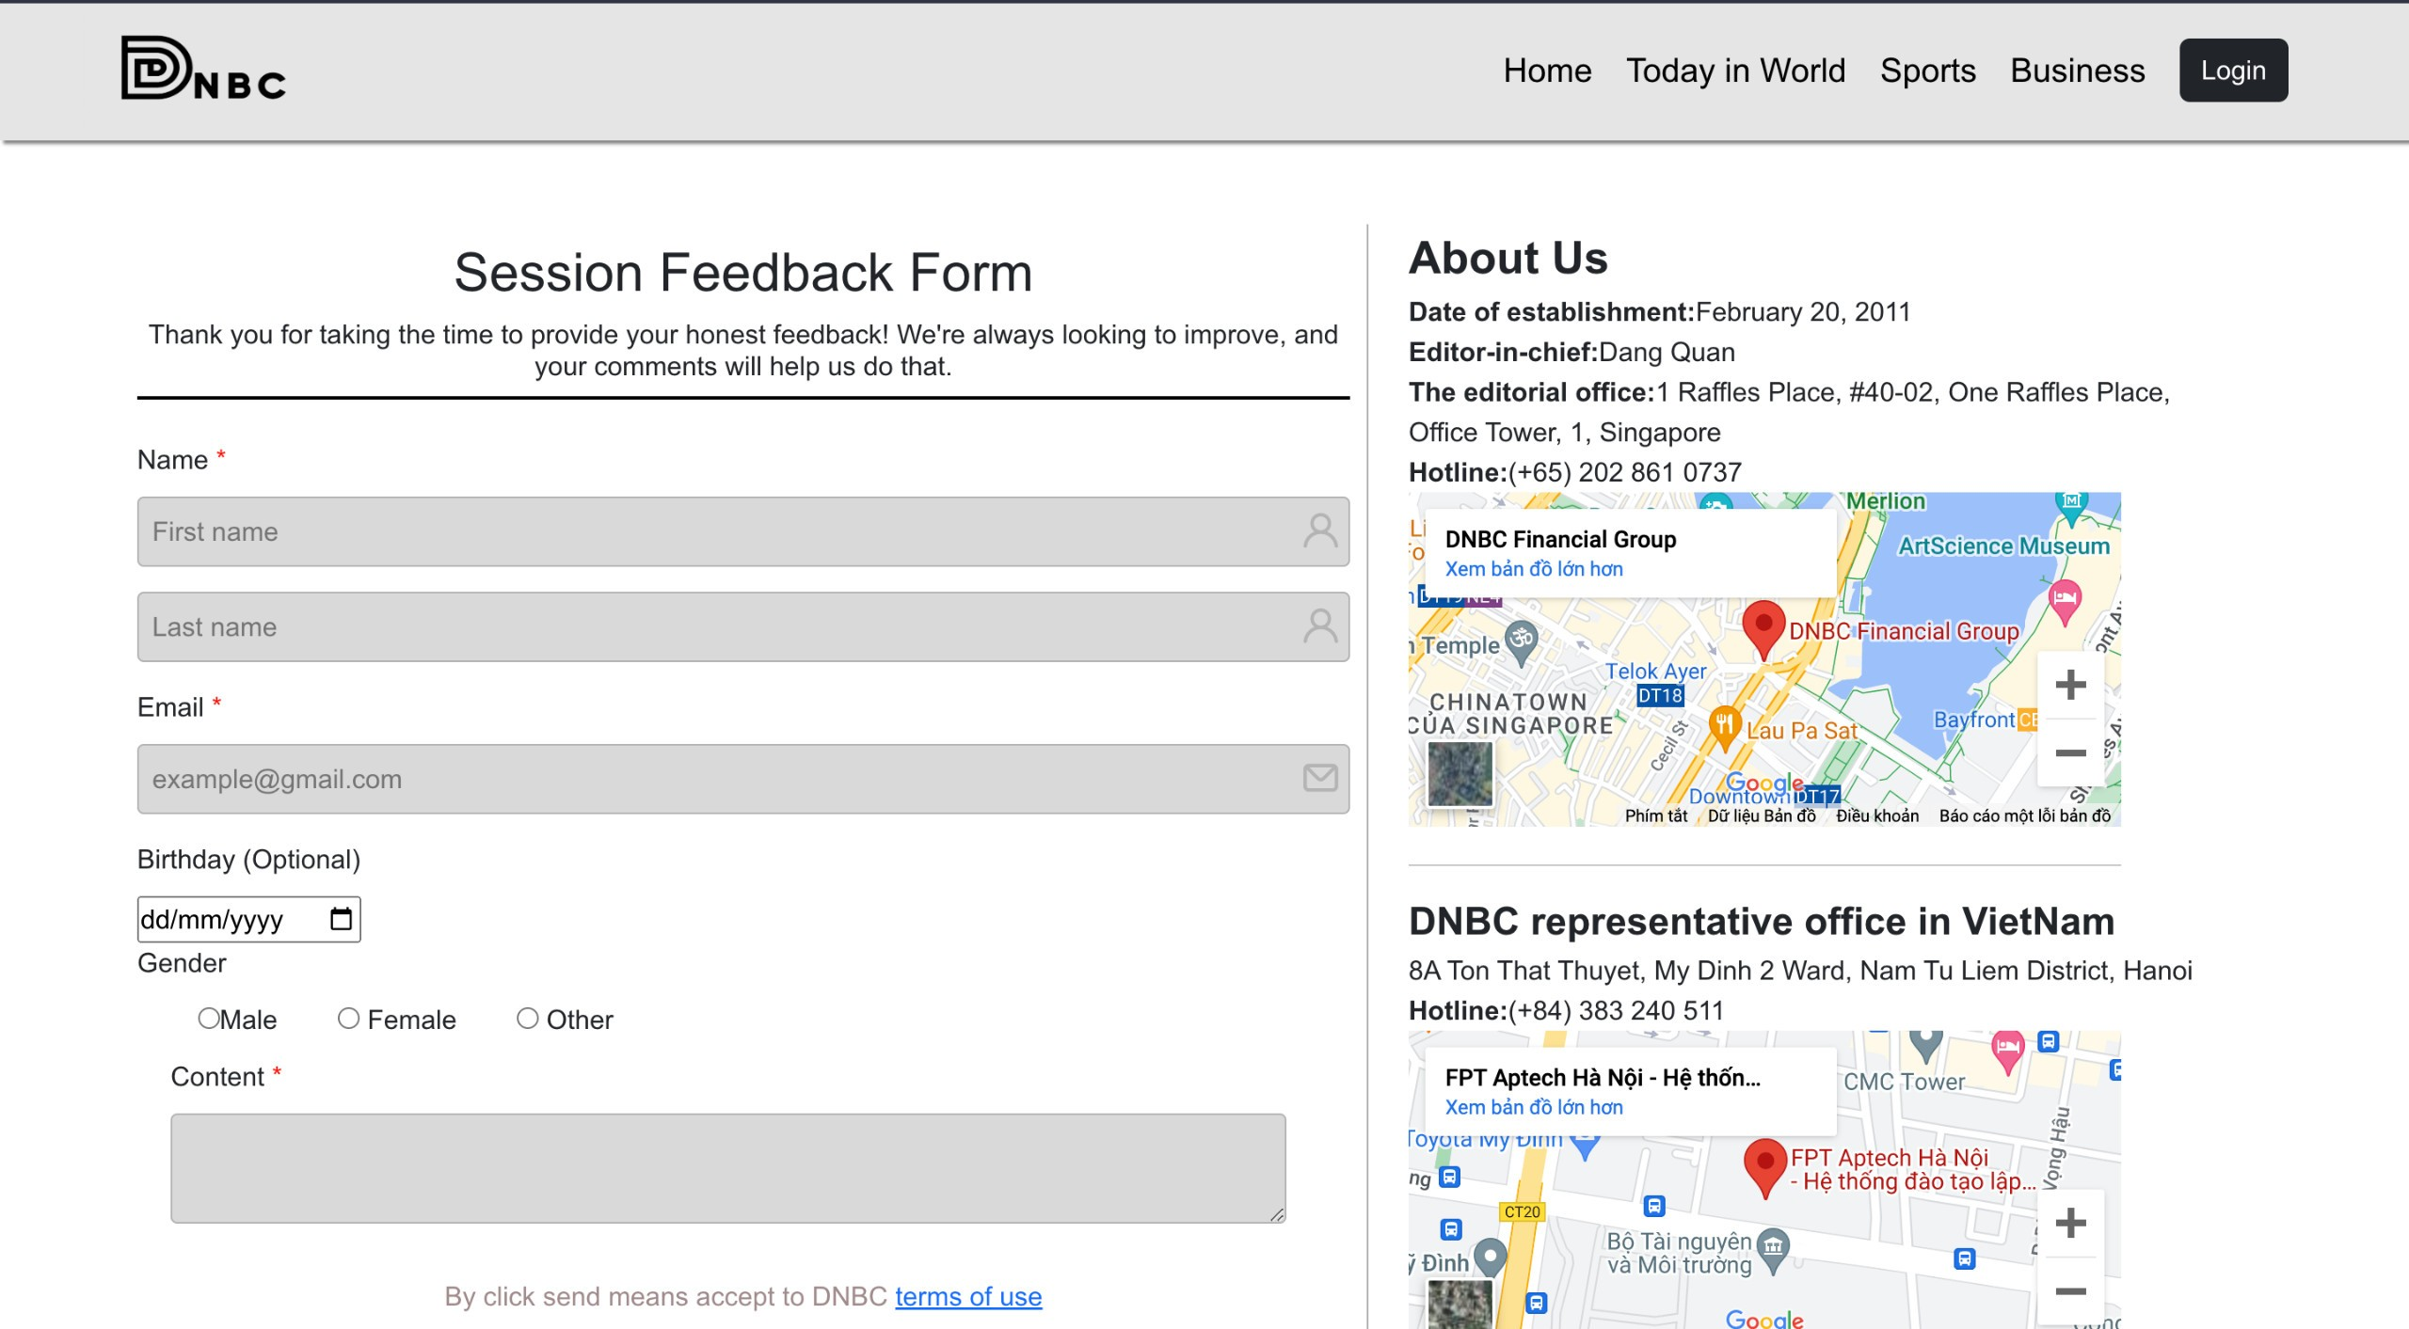
Footer
Feedback Form

Slide 8
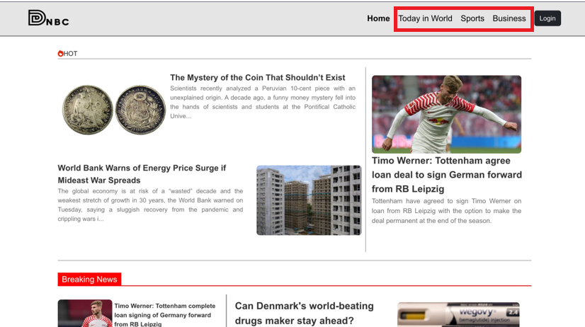
We divide the newspaper into many categories

Slide 9
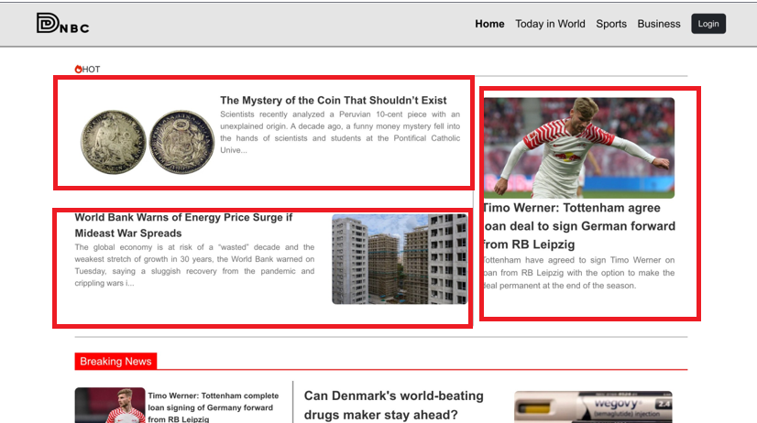
Displaying a piece of information helps readers understand part of the article

Slide 10
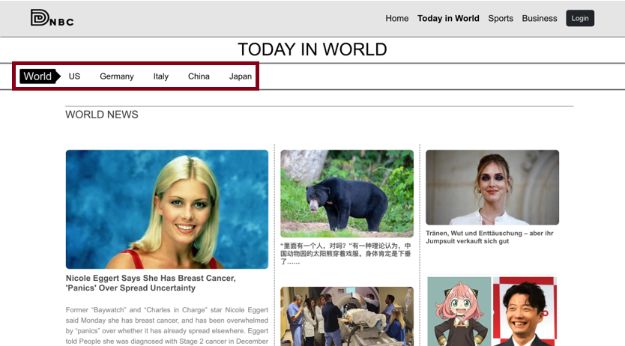
In the today in world page we have divided the countries and their languages

Slide 11
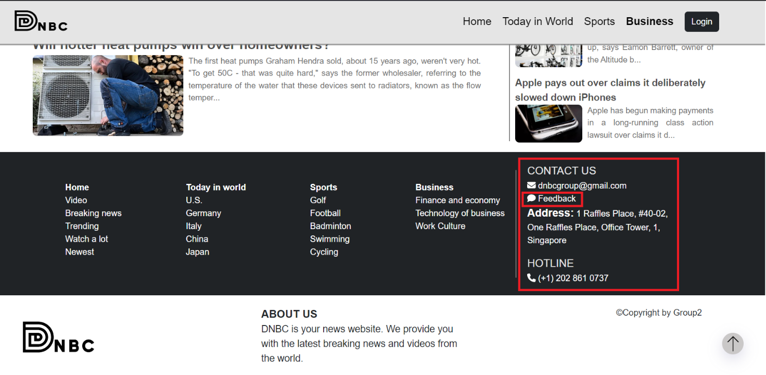
We have contact us and feedback sections in the footer of every page

Slide 12
When you click on the feedback button, it will switch to the feedback page

Slide 13
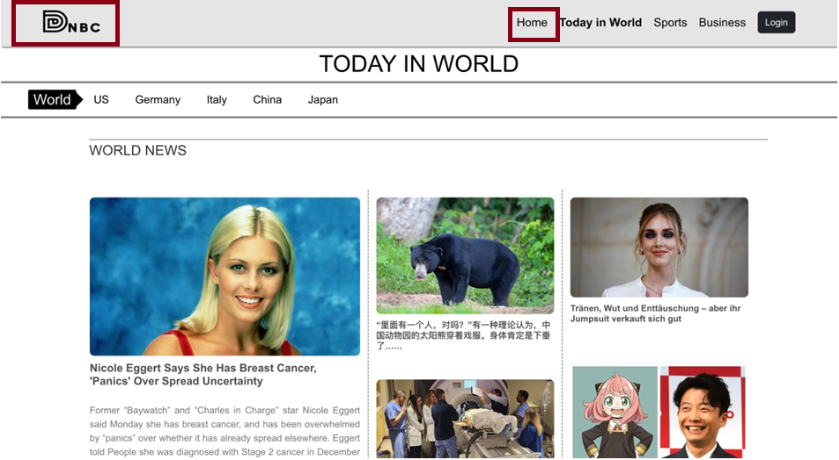
To return to the homepage, we can click on the home button or the web logo

Slide 14
T2307A-FPT Aptech Hanoi
Group 2
That's it. Thank you for watching

